Slide 1



SAP Process Integration
Integration Directory
Day 3
16th – 20th
March, 2020
Trainer: Gopal
Kirti

Slide 2


Integration Directory
Agenda
1
Overview on Integration Directory
Key differences in Dual Stack and Single Stack
Types of Integration Scenario Configurations in Dual and Single stacks
Configuration Tasks and Tools
Integration Scenarios
-Classical Configurations
-Integrated Configurations (ICO)
-Integration Flows (IFlows)
2
3
4
5
Copyright © Capgemini 2016 All Rights Reserved
2

Slide 3


Overview on Integration Directory
Copyright © Capgemini 2016. All Rights Reserved
11

Slide 4
Overview on Integration Directory
The Integration Directory (ID) is used to configure the integration scenarios at Configuration time by using the integration objects created at design time in the ESR and Business Systems created in SLD.
Connectivity between heterogeneous applications (A2A) and business systems (B2B) can be achieved through ID.
The ID is initially delivered without content. The Customer must add content that corresponds to the concrete landscape of the customer solution. The ID content can be partially derived from the content of the ESR. For instance, Process Models in the ESR are the basis for the Process Integration Scenario in the ID.
Copyright © Capgemini 2016. All Rights Reserved
3

Slide 5
Overview on Integration Directory
J2EE based adapters can be configured centrally in the ID. AAE provides the set of adapters which gets used in configuring the integration scenarios to connect heterogeneous systems (like file, database, SAP ECC etc.,) in the integration landscape of the organization.
AAE processes messages locally without the involvement of the IE. AAE ensures a considerably higher performance. Integrated Configuration Objects(ICO) uses this capability to develop the interfaces using AAE. How ever, processing of the messages locally on the AAE provides 95% of the mediation capabilities the combination (IS and AAE) provides.
In Single Stack installation Advanced Adapter Engine Extended (AEX) provides the connectivity capabilities of the AAE as well as the design and configuration tools (ESR and the ID) to set up scenarios based on the AAE.(See Notes)
Copyright © Capgemini 2016. All Rights Reserved
3
Notes:
Since AEX is based on AS Java alone, it is easier to install and maintain as it needs less memory and data storage. Therefore, AEX is a cost-saving option compared to a full installation of SAP NetWeaver PI.

Slide 6
Key differences in Dual Stack and Single Stack
Copyright © Capgemini 2016. All Rights Reserved
11

Slide 7
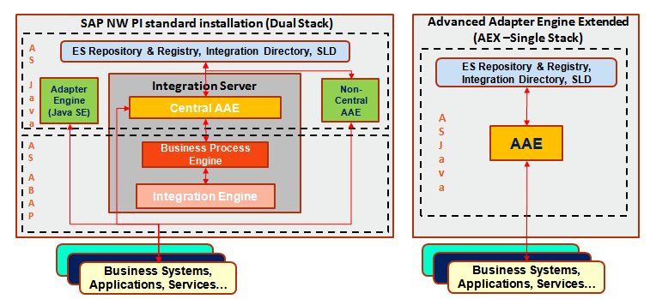
Architecture (Dual Stack and AEX)
Copyright © Capgemini 2016. All Rights Reserved
3

Slide 8
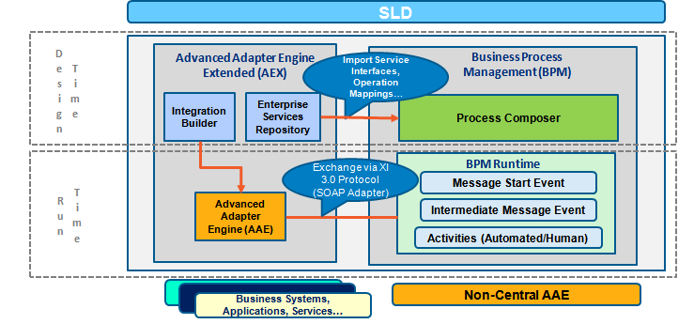
Architecture (SAP PO)
Copyright © Capgemini 2016. All Rights Reserved
3
Notes:
SAP NetWeaver Process Orchestration bundles the SAP NetWeaver Business Process Management (SAP NetWeaver BPM), SAP NetWeaver Business Rules Management (SAP NetWeaver BRM), and SAP NetWeaver Process Integration (SAP NetWeaver PI) in a single, integrated solution.

Slide 9
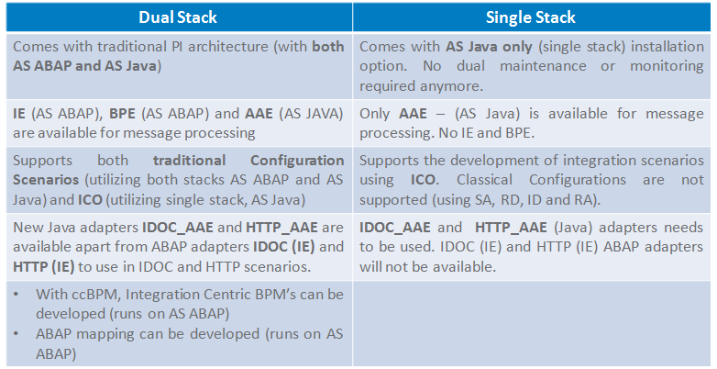
Key differences in Dual Stack and Single Stack
Copyright © Capgemini 2016. All Rights Reserved
3

Slide 10
Types of Integration Scenario configurations and its availability in Dual and Single Stacks
Copyright © Capgemini 2016. All Rights Reserved
11

Slide 11
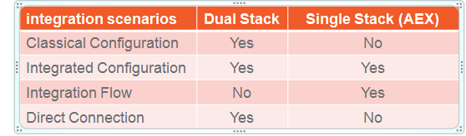
Types of Integration Scenario configurations and its availability in Dual and Single Stacks
Below are the different types of integration scenarios that can be created in Integration Directory.
Classical configurations: Integration Scenarios can be constructed by defining Communication Channels and all the pipeline steps (Sender Agreement, Receiver Determination, Interface Determination and Receiver Agreement) utilizing both IE and AAE capabilities.
Copyright © Capgemini 2016. All Rights Reserved
9

Slide 12
Types of Integration Scenario configurations and its availability in Dual and Single Stacks
Integrated Configurations: Through ICO, Integration Scenarios can be constructed by configuring Collaboration profiles and agreements. ICO processes messages locally on the AAE. It bypasses the IE in case of Dual Stack installation.
Integration Flows: Through IFlows, Integration Scenarios can be constructed by using the Business Process Modeling Notation (BPMN) in NWDS and deployed in ID (Java Swing application). An ICO will be constructed automatically and will get assigned to the Integration Flow object in ID.
Direct Connections: Through Direct Connection, two systems use the web service runtime to communicate with each other directly without using a central Integration Server or the AAE. The configuration steps are minimal in the ID for Direct Connection configuration.
Copyright © Capgemini 2016. All Rights Reserved
9
Notes:
The integration flow is a graphical model that consists of endpoints (systems, interfaces and channels) and flow steps (activities that enable integration). When you create an integration flow, a corresponding integrated configuration is created in the Integration Directory.

Slide 13
Configuration Tasks and Tools
Copyright © Capgemini 2016. All Rights Reserved
11

Slide 14
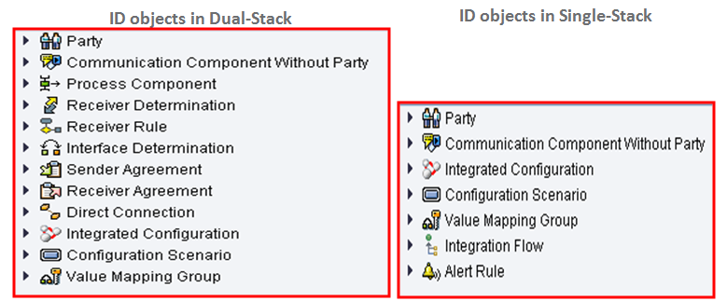
Integration Directory Objects
Copyright © Capgemini 2016. All Rights Reserved
9

Slide 15
Configuration Tasks and Tools
Following tasks should be performed at configuration time
Determining the system landscape - Identify systems which are involved in integration scenario. Define the relevant systems in the System Landscape Directory (SLD).
Determining how the messages are exchanged between the systems - Specifying how messages should be exchanged between the systems in accordance with the interface objects specified at design time.
To perform this task, following objects needs to be defined in Integration Directory:
Collaboration Profiles
Collaboration Agreements
Routing and Mapping
Copyright © Capgemini 2016. All Rights Reserved
9

Slide 16
Configuration Tasks and Tools
Collaboration Profiles:
Communication Party - Represents a company unit which involves in message exchange.
Communication Component - Represents an entity that is used as a sender or receiver of messages (Business System or Business Component).
Communication Channel - Defines the rules on how to handle messages during inbound or outbound processing. A Communication Channel is used to define the type of the adapter and its configuration (connectivity) during inbound or outbound processing.
Copyright © Capgemini 2016. All Rights Reserved
9

Slide 17
Configuration Tasks and Tools
Collaboration Agreements
Inbound Processing – Inbound processing defines how the incoming message has to be transformed technically to XML message structure that the PI runtime can understand. It contains sender partner details and also includes security-relevant features (Certificate paths etc.,).
Outbound processing - Defines how the incoming message has to be transformed technically with respect to a specific receiver. Outbound processing implies a technical transformation step. Conversion from XML message structure to the message structure that the runtime environment can follow the protocol to transmit the message, which receiver system can handle.
Copyright © Capgemini 2016. All Rights Reserved
9

Slide 18
Configuration Tasks and Tools
Routing and Mapping
Routing - Defines to which receivers the incoming message is to be sent to. The configuration of routing might also include routing conditions.
Mapping - Defines how the business data of message is to be converted to receiver message structure and data.
Copyright © Capgemini 2016. All Rights Reserved
9

Slide 19
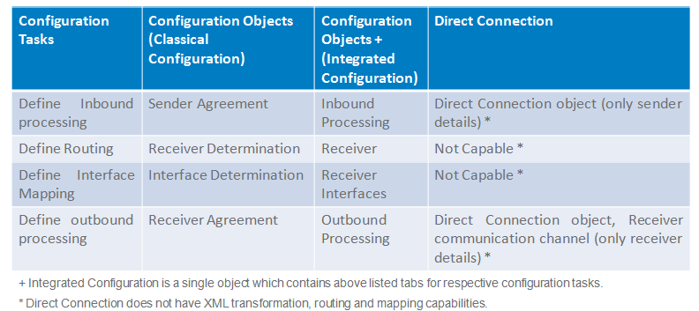
Configuration Tasks and Tools
Copyright © Capgemini 2016. All Rights Reserved
9

Slide 20
Integrated Configurations
Copyright © Capgemini 2016. All Rights Reserved
11

Slide 21
Classical Configurations (Dual Stack only)
Configuration Scenario
Using Configuration Scenario, configuration objects can be grouped to structure the content of Integration Directory. It groups the configuration objects (Collaboration Profiles, Collaboration Agreements, Routing Rules and Mapping) relevant to one or more related integration scenarios.
Once a configuration scenario is created in ID, Process Model created in the ESR can be used to build a configuration template.
All configuration objects that are assigned to a Configuration Scenario can be transported together and activated for runtime. While transporting the individual configuration objects, the configuration scenario also needs to be transported.
Copyright © Capgemini 2016. All Rights Reserved
9

Slide 22
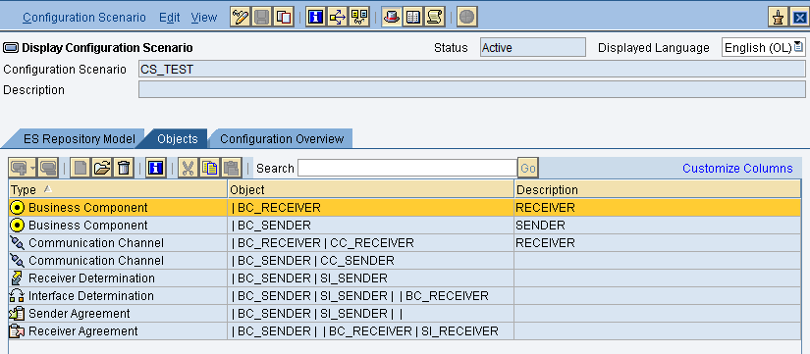
Classical Configurations (Dual Stack only)
The Configuration Scenario provides below tabs for better understanding of the objects
Copyright © Capgemini 2016. All Rights Reserved
9

Slide 23
Classical Configurations (Dual Stack only)
Collaboration Profiles - Communication Party
The optional object Party facilitates the B2B functions of PI. It represents a larger-unit like a company which is involved in a cross-system process.
A party groups communication components together that belong to the corresponding company or organization.
A Communication party can be assigned one or more communication components that act as the sender or receiver of the messages.
Party contains the following information:
Name and description (It is always recommended to provide a meaningful name to the party )
Additional Identifiers (DUNS, DUNS+4, GLN)
Assigned Business System and Services.
Copyright © Capgemini 2016. All Rights Reserved
9

Slide 24
Classical Configurations (Dual Stack only)
The name that is given to the party may not match any valid external names provided for the party. So, to use additional identifiers, you can also specify alternative identifier. Alternative Identifiers have the following properties:
Agency: An abbreviation for the agency
Schema: An Identification Scheme
Value: This value is unique identifier for communication party within the specified scheme (for example the DUNS number)
Copyright © Capgemini 2016. All Rights Reserved
9

Slide 25
Classical Configurations (Dual Stack only)
Collaboration Profiles - Business Component
Business Component defines those entities that interact with each other based on the exchange of XML messages.
Business Component (Communication Component) is the representation of the systems or applications at configuration time.
A Business Component is an abstract unit that is used as the sender and receiver of messages.
Business Components can be used in the cross-company process, for instance, if the parties involved have only published their interfaces and not their SLD, or it is only partly known.
Copyright © Capgemini 2016. All Rights Reserved
9

Slide 26
Classical Configurations (Dual Stack only)
Collaboration Profiles - Business System
A Business System is the actual application system in SLD.
A Business System (Communication Component) contains details of the inbound interface and outbound interfaces and the SWCVs of the business system.
The Business Systems are created in SLD and therefore cannot be edited in anyway in the Integration Directory.
Sender/Receiver Tab: Contains information about the Outbound/Inbound Interfaces and the Communication Channels assigned to the Business System.
IDOC Partner Tab: This tab page provides details of all parties defined in the Integration Directory whose business system has an identification scheme. This information is useful incase if the business system communicates with the Integration Server using the IDOC adapter.
Copyright © Capgemini 2016. All Rights Reserved
9

Slide 27
Classical Configurations (Dual Stack only)
Other Attributes Tab: This tab page Shows if the business system is registered as a third-party system or as a SAP system.
Logon Data for Cache Notifications Tab: This tab page shows whether a business system can communicate using the Web service runtime.
Copyright © Capgemini 2016. All Rights Reserved
9

Slide 28
Classical Configurations (Dual Stack only)
Collaboration Profiles - Communication Channel
A communication channel consists of information about the message protocol, transport protocol, URL, logon data and adapter specific configuration.
The adapters are configured in the communication Channel.
Sender Channel - Defines how an adapter should transform a message such that it is in the acceptable format during inbound processing by the Integration Engine . A sender channel contains the configuration details for a sender adapter.
Receiver Channel - Defines how the message should be transformed so that the message can be processed during the outbound processing by the receiver . A receiver channel contains the configuration details for a receiver adapter.
A communication channel is always required to be assigned to a communication component or communication party
Copyright © Capgemini 2016. All Rights Reserved
9

Slide 29
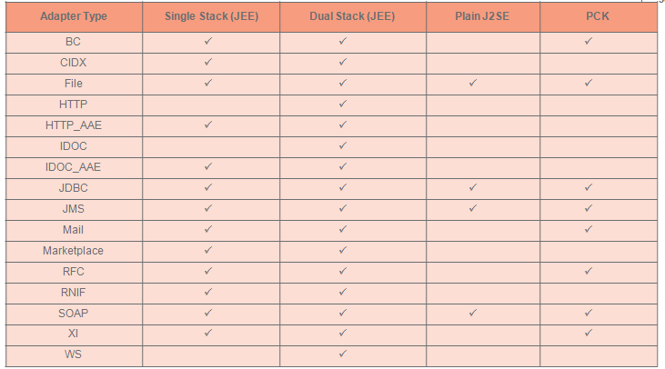
Classical Configurations (Dual Stack only)
Copyright © Capgemini 2016. All Rights Reserved
9

Slide 30
Classical Configurations (Dual Stack only)
Routing and Mapping - Receiver Determination
A Receiver Determination is used to identify the receiver or receivers of a message.
Conditions can be specified to route messages to particular receivers.
Content-based receiver determination is possible (via XPATH/Context Objects).
Receiver should be an existing component (with or without party).
The receiver of a message can be determined dynamically at runtime using mapping by using the content from the message payload. Such a receiver determination is called Extended Receiver Determination.
Copyright © Capgemini 2016. All Rights Reserved
9

Slide 31
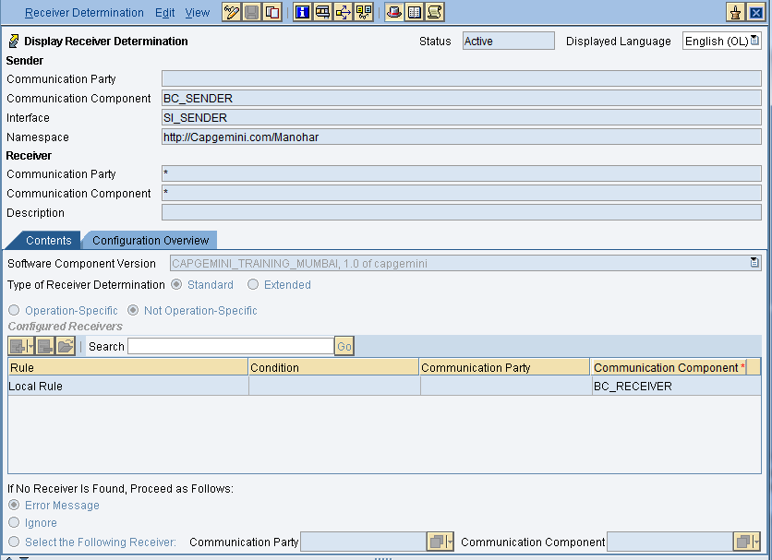
Classical Configurations (Dual Stack only)
Copyright © Capgemini 2016. All Rights Reserved
9

Slide 32
Classical Configurations (Dual Stack only)
Routing and Mapping - Interface Determination
An Interface Determination helps to specify the inbound interface of a specified receiver to which the message has to be sent and also to define what mapping is to be used to transform the message.
Certain conditions under which the message is to be sent to the specified interface can be mentioned.
Interface Determination can be used to configure a mapping-based message split.
Copyright © Capgemini 2016. All Rights Reserved
9

Slide 33
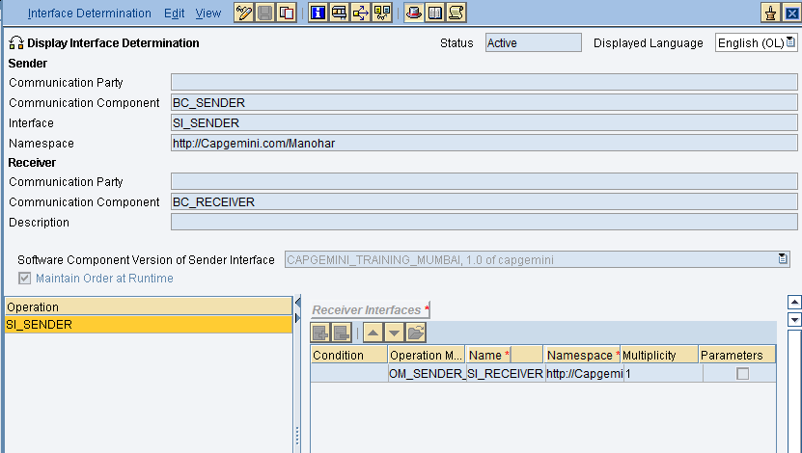
Classical Configurations (Dual Stack only)
Copyright © Capgemini 2016. All Rights Reserved
9

Slide 34
Classical Configurations (Dual Stack only)
Collaboration Agreements - Sender Agreement
Specify a binding between an interface and a Communication Channel
Contain additional security settings, such as certificate path, principal propagation properties etc.,
On the Integration Server, the Sender Agreement is used for inbound processing, the receiver agreement for outbound processing.
In inbound processing, one can use security settings to identify the signature of an inbound message, to authorize the sender of a message and to check the integrity of the data.
Sender Agreement can be configured to validate the payload. Validation can be done against the sender adapter or Integration Engine.
Sender Agreement is not required for client proxy communication.
Copyright © Capgemini 2016. All Rights Reserved
9

Slide 35
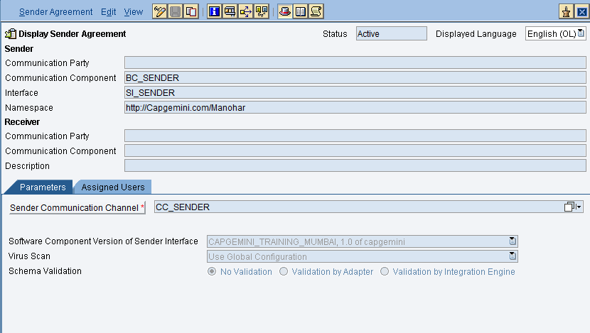
Classical Configurations (Dual Stack only)
Copyright © Capgemini 2016. All Rights Reserved
9

Slide 36
Classical Configurations (Dual Stack only)
Collaboration Agreements - Receiver Agreement
Receiver Agreement is used to define the outbound processing of a message.
To guarantee the execution of the outbound processing correctly ,specify a receiver agreement.
Receiver Agreement can be configured to validate the payload.
The Receiver Agreement assigned to communication channel with XI adapter, SOAP, CIDX,WS or Mail can be used to specify further adapter-specific attributes.
For scenarios where communication is based on web service runtime or proxy runtime, the service provider automatically sends statistical information about all service consumers that calls it. It is activated for integration scenarios where there is an Integration Server between service consumers and providers.
Copyright © Capgemini 2016. All Rights Reserved
9

Slide 37
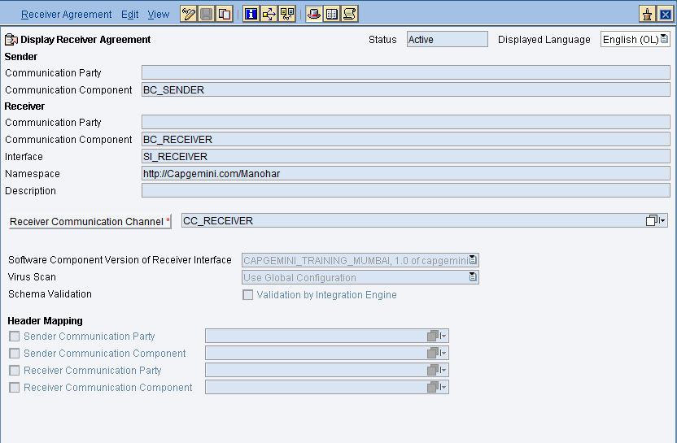
Classical Configurations (Dual Stack only)
Copyright © Capgemini 2016. All Rights Reserved
9

Slide 38
Integrated Configurations (Single and Dual Stack)
Integrated Configuration
Starting from PI 7.1, Sender and Receiver systems can communicate directly using AAE thus bypassing the need for IE.
The central configuration ID object that is to be created for these kind of scenarios is, the Integrated Configuration (ICO).
The integration scenario created through ICO, processes the messages locally in AAE. Thus, allows message processed completely in Java Stack.
Along with regular message processing steps, almost all the features available in Classical configurations like Technical Routing, Extended Receiver Determination, Message Splits, Header Mapping can be achieved through ICO.
Supports all adapters available in Java stack (including IDOC_AAE and HTTP_AAE).
Copyright © Capgemini 2016. All Rights Reserved
9

Slide 39
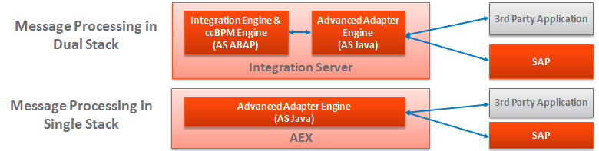
Integrated Configurations (Single and Dual Stack)
Integrated Configuration
Since ICO doesn’t process the messages in ABAP stack (Integration Engine), below are few limitations while building the integration scenarios using ICO.
ccBPM is not supported
ABAP Mapping is not supported
WS-RM adapter is not supported
Copyright © Capgemini 2016. All Rights Reserved
9

Slide 40
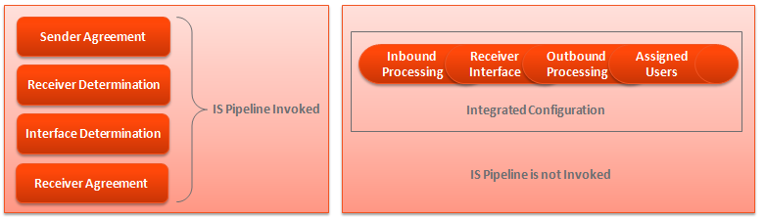
Integrated Configurations (Single and Dual Stack)
Integrated Configuration
New Directory object, which includes multiple configuration objects into one. Hence called “Integrated” configuration object. Needs Inbound Processing, Receiver, Mapping and Outbound Processing tabs configured in the same ICO object.
Copyright © Capgemini 2016. All Rights Reserved
9

Slide 41
Integrated Configurations (Single and Dual Stack)
Integrated Configuration
ICO can be created both in Dual and Single Stack installation options of PI.
Integrated Configuration is a single configuration time object created for a scenario containing all the configuration tasks.
ICO completely runs on Java Stack leveraging AAE capabilities. The ICO is transferred as one single object to the AAE.
ICO transferred to the CPA cache of the individual AAE with a reference to the mapping maintained in interface determination.
For each operation in interface determination a separate entry is created in CPA.
In PI 7.31, advanced features like Extended Receiver Determination, Parameterized Mapping, Message Splits, Staging and Logging etc., are introduced in ICO.
Copyright © Capgemini 2016. All Rights Reserved
9

Slide 42
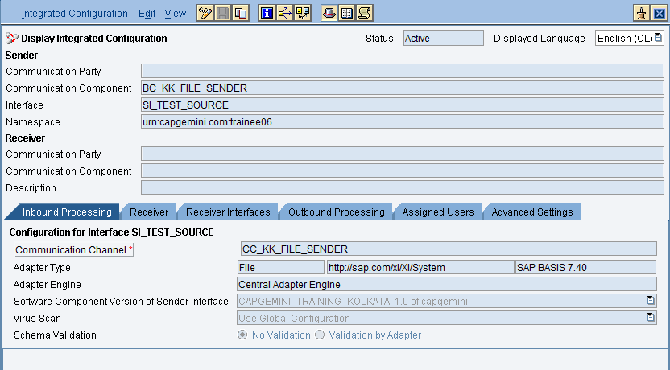
Integrated Configurations (Single and Dual Stack)
Copyright © Capgemini 2016. All Rights Reserved
9

Slide 43
Integration Flow (Single Stack only - AEX)
Integration Flow
From PI/PO 7.31, SAP has introduced Integration Flow (IFlow), to configure the integration scenarios using the NWDS (Eclipse based tool).
IFlow is a BPMN-based model that is executable on the service bus of SAP NetWeaver PI. IFlow created in NWDS can be deployable on the Integration Directory (Swing application) as an Integration Flow. When deployed, an ICO will be created and assigned to the Integration Flow in the ‘Integration Directory’.
The integration scenario created through IFlow, processes the messages locally in Advanced Adapter Engine. Thus, allows message processed completely in Java Stack.
Along with regular message processing steps, almost all the features available in Classical configurations like Technical Routing, Extended Receiver Determination, Message Splits, Header Mapping can be achieved through IFlow.
Copyright © Capgemini 2016. All Rights Reserved
9

Slide 44
Integration Flow (Single Stack only - AEX)
Integration Flow
Supports all adapters available in Java stack (including IDOC_AAE and HTTP_AAE).
Since ICO will be created when an IFlow is deployed in ID, as ICO, IFlow doesn’t process the messages in ABAP stack (Integration Engine), below are few limitations while building the integration scenarios using ICO.
ccBPM is not supported
ABAP Mapping is not supported
WS-RM adapter is not supported
iFlow is based on BPMN, which is also used by NetWeaver BPM. With 7.3.1 (PO), PI, BPM and BRM are combined as a single product call Process Orchestration and can be installed in the same SID (this applies only to AEX). All the development and configuration tools for all the components are now available in Eclipse (NWDS).
Copyright © Capgemini 2016. All Rights Reserved
9

Slide 45
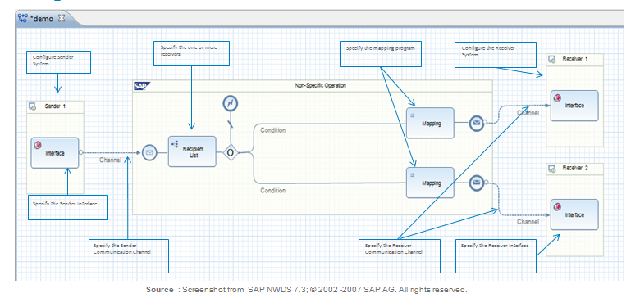
Integration Flow (Single Stack only - AEX)
Copyright © Capgemini 2016. All Rights Reserved
9

Slide 46
Routing Rules
Collaboration Agreements
Copyright © Capgemini 2016. All Rights Reserved
17

Slide 47
SAP Process Integration
Introduction
1
2
Application Environment
3
Demonstration
4
Hands On
5
HelpMe
Copyright © Capgemini 2016. All Rights Reserved
24

Slide 48
Integration Directory Demo
ID Demo
Copyright © Capgemini 2016. All Rights Reserved
26

Slide 49
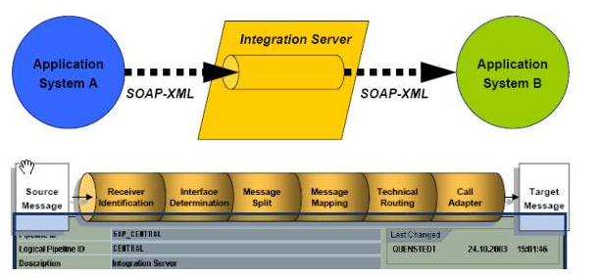
SAP PI Pipeline Steps
Copyright © Capgemini 2016. All Rights Reserved
3

Slide 50
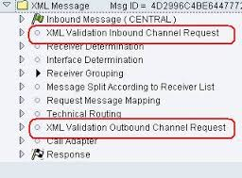
SAP PI Pipeline Steps

Slide 51
SAP PI Pipeline Steps
PIPELINE Steps:
Receiver Identification:
To determine which systems should participate in an exchange with the incoming message.
Interface Determination: For each receiver system determine which interface should receive a message.
Message Branch:
If multiple receivers are found, XI instantiate a new message for each receiver
Request Message Mapping:
Call the mapping program to transform the message structure to the receiver format.
Outbound Binding:
Bind a specific destination and protocol to the message.
Call Adapter:
Send the transformed message to the adapter or proxy.
Copyright © Capgemini 2016. All Rights Reserved
6

Slide 52
SAP PI Pipeline Steps
Thank You
Copyright © Capgemini 2016. All Rights Reserved
6

